Slide 1


STATISTICS
Session 4: Measurement Error

Slide 2
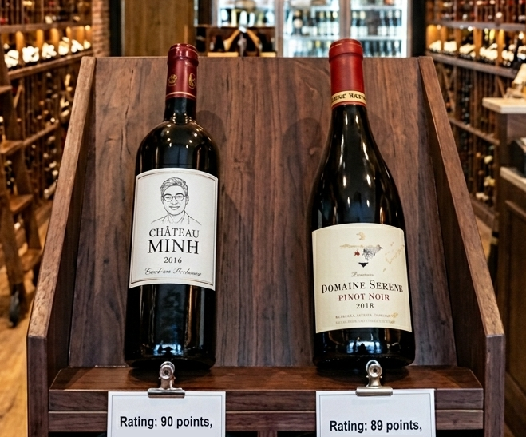
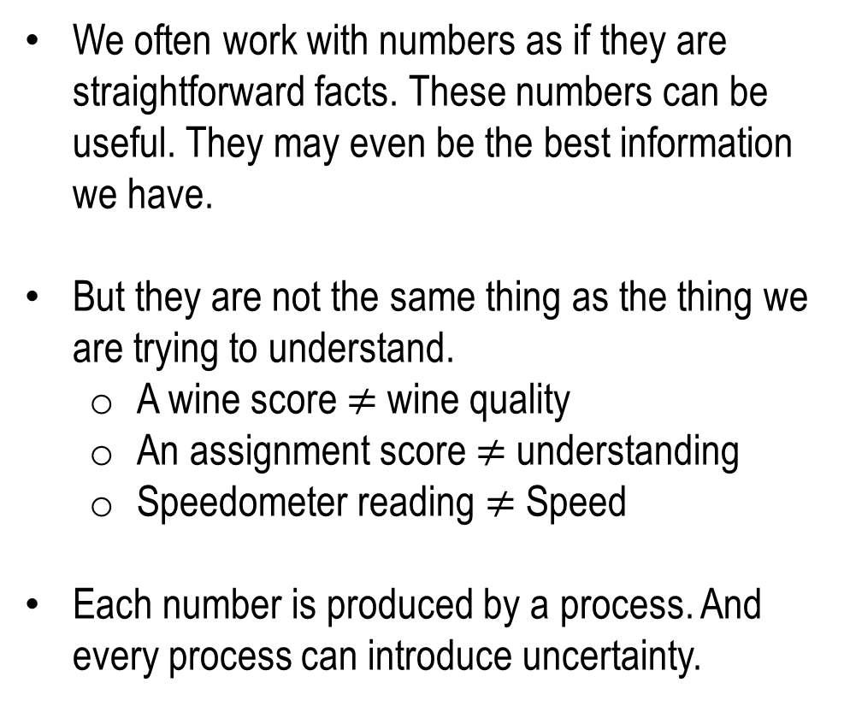
Measurement
We often work with numbers as if they are straightforward facts. These numbers can be useful. They may even be the best information we have.
But they are not the same thing as the thing we are trying to understand.
  A wine score $≠$ wine quality
  An assignment score $≠$ understanding
  Speedometer reading $≠$ Speed
Each number is produced by a process. And every process can introduce uncertainty.

Slide 3
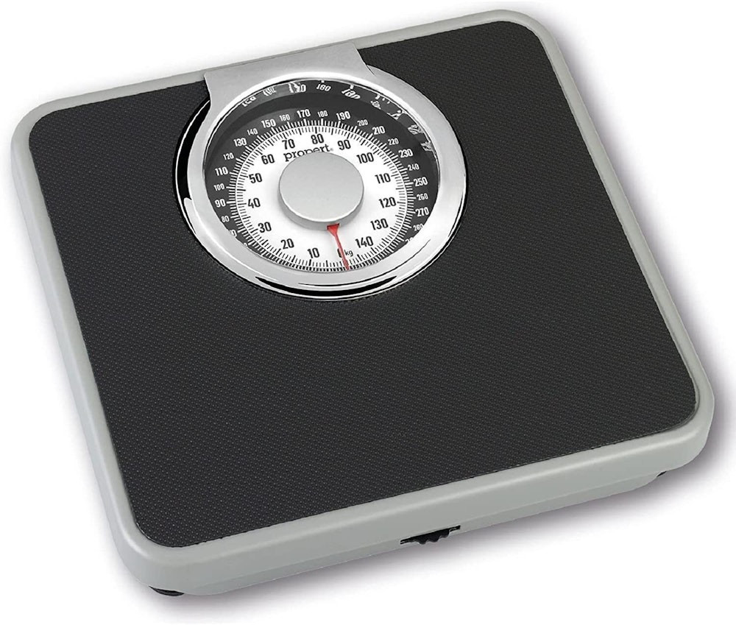
Random Error
Not all errors are the same. Imagine a bathroom scale. Suppose you step on it five times in a row and it gives you the following: 70.1, 69.9, 70.3, 69.9, 70.0
The readings are not identical, but they are close. The differences might be due to how you stood on the scale, tiny changes in the floor, or small imperfections in the instrument. This is an example of random error.
Random error is the kind of error that varies from measurement to measurement. It does not follow an obvious direction in a single observation, but over repeated measurements we may begin to see its pattern.

Slide 4
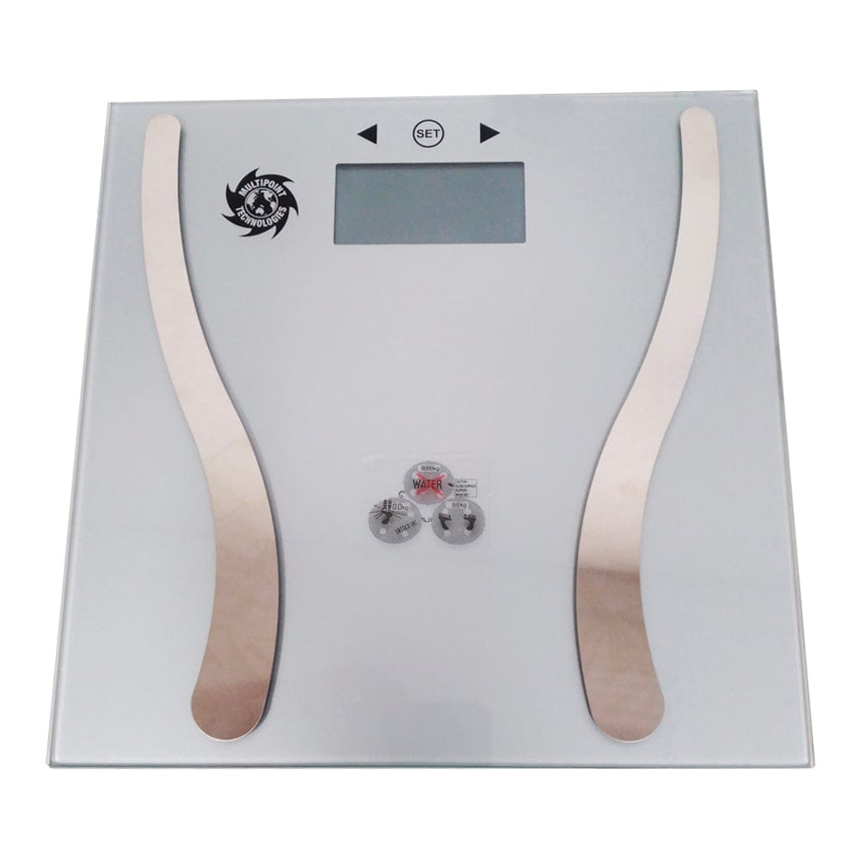
Systematic Error
Now imagine a different scale. This scale is faulty. Every time you step on it, it adds ~2 kilograms.
If your true weight is 70 kilograms, the scale might show: 72.1, 71.8, 72.3, 71.9, 72.0
Repeated measurement does not automatically fix systematic error. If a scale is always 2 kilograms too high, weighing yourself one hundred times will not solve the problem.

Slide 5
Random and Systematic Error
Observed value = True value + Systematic Error + Random Error
Type of Error | Description
Random | Measurement varies unpredictably from one observation to the next.
Systematic | Measurement is consistently pushed in one direction.

Slide 6
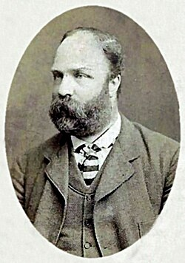
Joseph Hobson Jagger
Engineer and Mechanic
Industry Businessman
Not a mathematician / statistician but “a man who broke the bank at Monte Carlo” by recognising systematic error at the roulette table.
A signal is a real pattern that tells us something about the process being measured. In Jagger’s case, the signal was the wheel's physical bias.
Noise is random variation that looks meaningful but does not reflect a real underlying pattern. A fair wheel might make one number appear usually often for a while, but that does not mean the number is truly favoured.

Slide 7
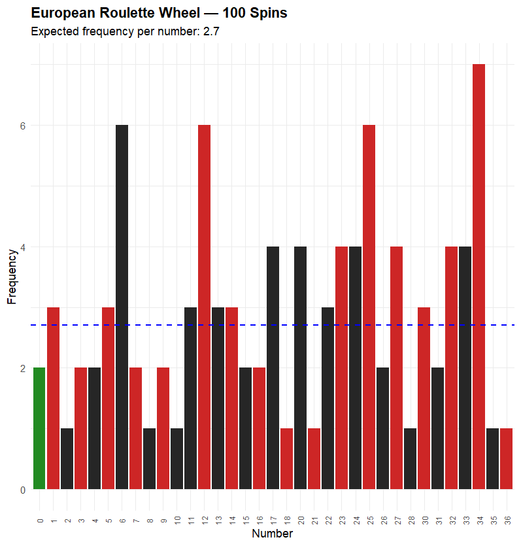
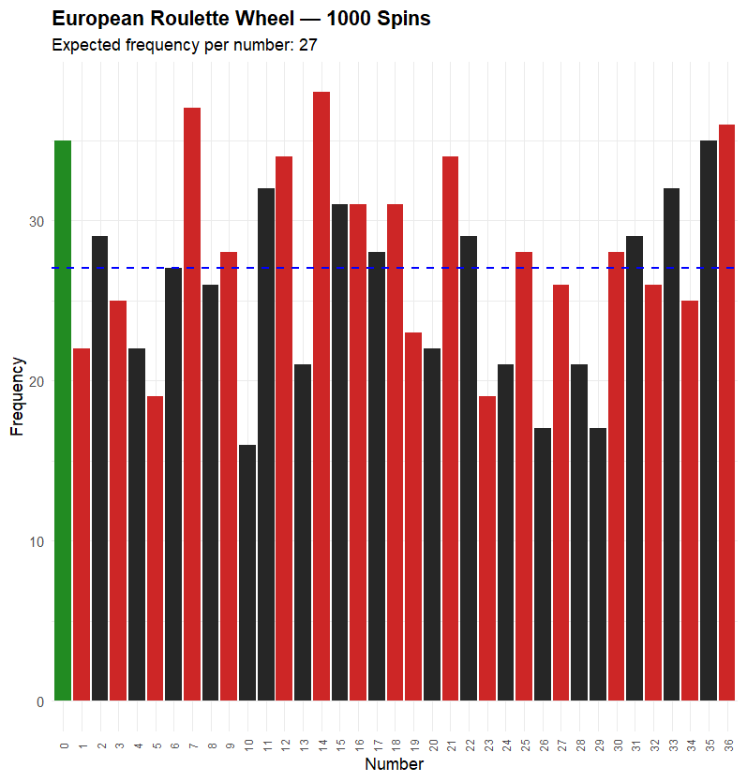
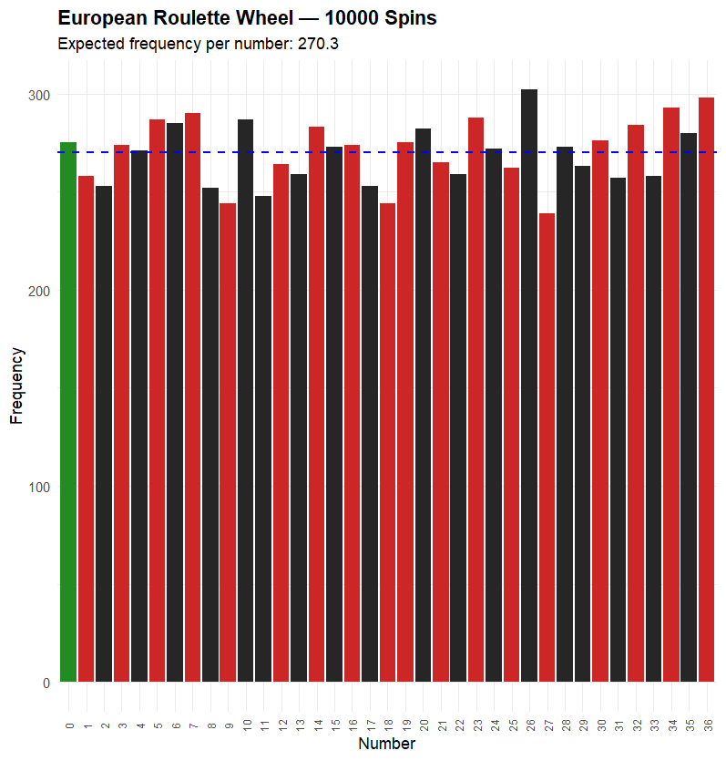
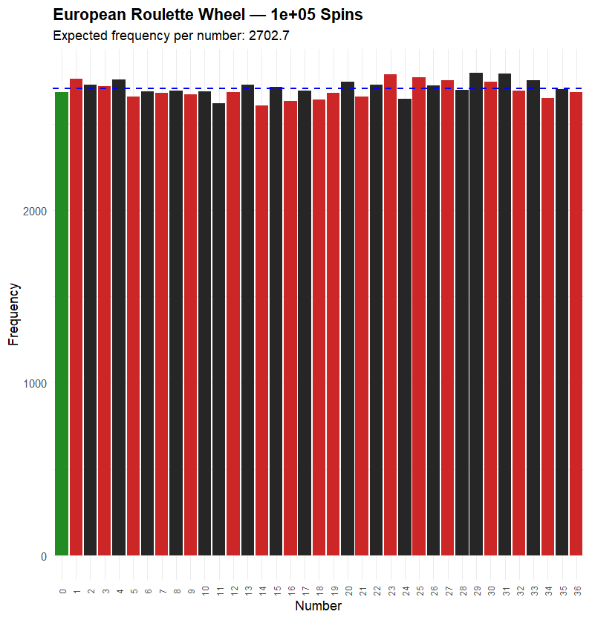
Joseph Hobson Jagger

Slide 8
Calculus & Statistics
Artificial Intelligence
21st century
Sequence
An ordered succession of elements, such as points or numbers.
Series
The sum of a sequence of numbers.
Limit
If the elements of a sequence seem to heading somewhere, such as an endpoint or a particular number, then that is the limit of the sequence.

Slide 9
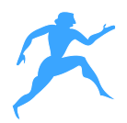
Calculus & Statistics – Zeno’s paradox
Suppose you are standing at a particular point in a room and you want to reach the door (which happens to be 1m away). Now before you reach the door you must reach the ½ way point. But before you reach the ½ point, you need to reach ½ way to the ½ way point (i.e. ¼ way). And so on, and so on.
Zeno argued that because the sequence goes on forever, you will have to travel an infinite number of finite distances. Zeno concluded that you must take an infinite amount of time.
Artificial Intelligence
21st century
1 metre

Slide 10
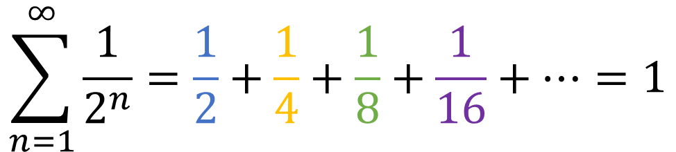
Calculus & Statistics – Zeno’s paradox
The pattern looks like that if we include more intervals, the greater the sum of the distances we obtain. But Zeno is not correct when he says that the sum is headed towards infinity.
Instead, the numbers seem to be approaching 1.
A modern mathematician, using the language of calculus, would say: 1 metre is the limit of this sequence of distances.
Artificial Intelligence
21st century
1/2
1/4
1/8
1/16
1 metre
$$\sum_{n=1}^{∞}{\frac{1}{2^{n}}=\frac{1}{2}+\frac{1}{4}+\frac{1}{8}+\frac{1}{16}+…=1}$$

Slide 11
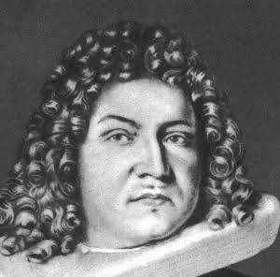
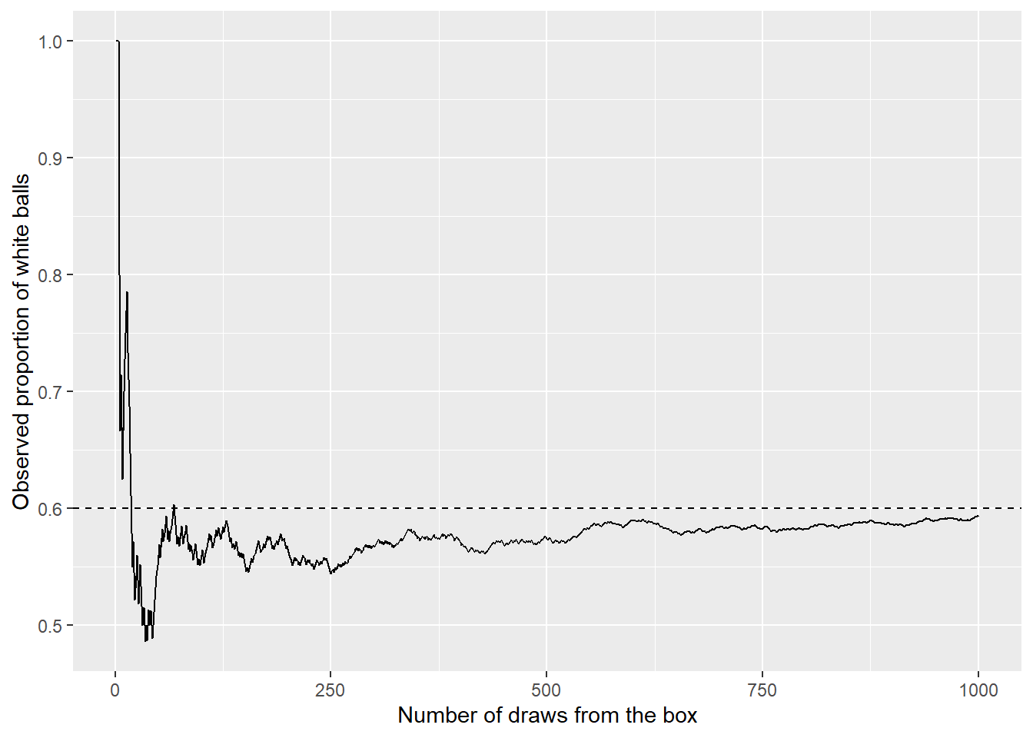

Jacob Bernoulli & The Law of Large Numbers
$${\hat{p}}_{n}→p$$

Slide 12
Jacob Bernoulli & The Law of Large Numbers
Repeated observations can reduce random error. They can help us see stable patterns. They can allow us to estimate probabilities that cannot be calculated in advance. But they do not remove the need to ask how the data were produced.

Slide 13
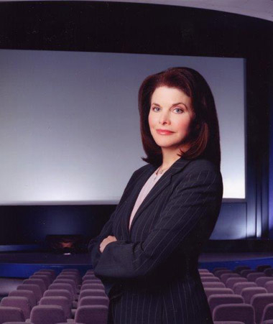
The Law of Small Numbers
Sherry Lansing
Former studio executive, Universal Music Group
Director of the board, Paramount Skydance
Chairwoman and CEO, Paramount Pictures
President of Production, 20th Century Fox

Slide 14








The Law of Small Numbers
Lansing produces several award winning movies, Revenue increases.
Lansing produces underperforming movies. Revenue decreases.
Lansing produces some of Paramounts best performing movies
Lansing let go

Slide 15
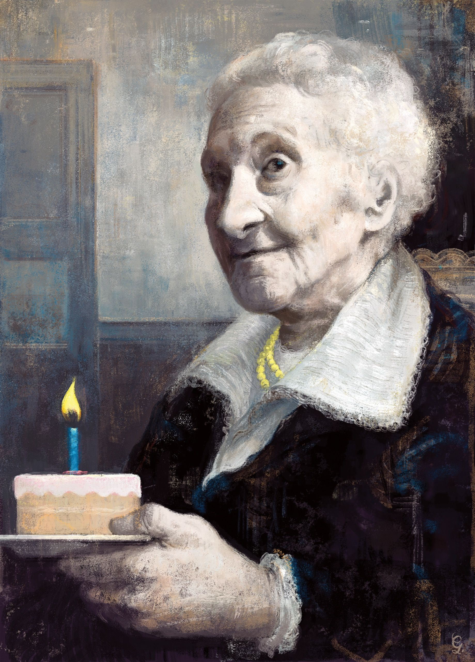
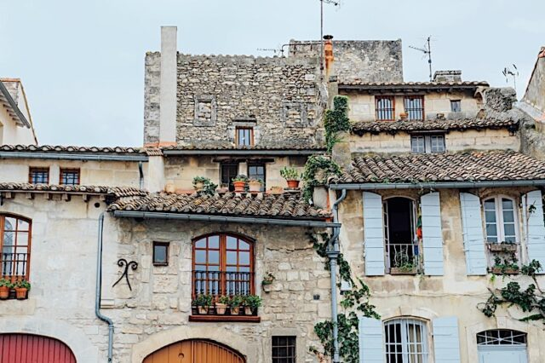
The Law of Small Numbers

Slide 16
The Law of Small Numbers
Calment: Aged 95
Lawyer: Aged 53
Deal made
Calment: Aged 105
Lawyer: Aged 63
Lawyer Died
Calment: Aged 115
Lawyer: Aged 73
Deal made
Calment: Aged 122
Calment died
Calment: Aged 90
Lawyer: Aged 47
Deal made
Calment: Aged 100
Lawyer: Aged 58
Deal made
Calment: Aged 110
Lawyer: Aged 68
Deal made
Calment: Aged 120
Lawyer: Aged 78
Lawyer died

Slide 17


The Law of Small Numbers
$$≠$$
$$P(live to 100)$$
$$P\left(live to 100 \right| already lived to 90)$$
Probability statement | Plain-language meaning | Why this matters
P(live to 100) | The chance that a newborn eventually reaches 100. | Includes all early and middle-life risks.
P(live to 100 | already lived to 90) | The chance that a 90-year-old reaches 100. | Only includes people who have already survived to age 90.

Slide 18
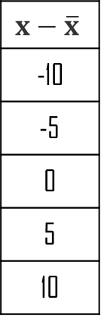
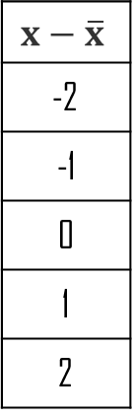
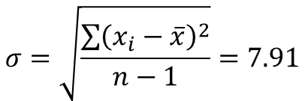
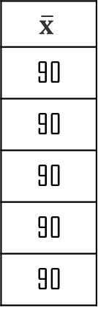
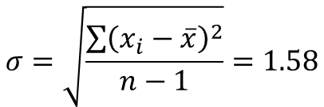

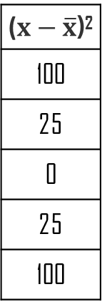
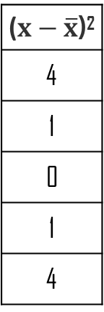
The Shape of Chance
Critic | x
Critic 1 | 88
Critic 2 | 89
Critic 3 | 90
Critic 4 | 91
Critic 5 | 92
$$\overline{x}$$
90
90
90
90
90
$$x−\overline{x}$$
-2
-1
0
1
2
($x−\overline{x}$)²
4
1
0
1
4
$$σ=\sqrt{\frac{\sum{{\left(x_{i}−\overline{x}\right)}^{2}}}{n−1}}=1.58$$
Critic | x
Critic 1 | 80
Critic 2 | 85
Critic 3 | 90
Critic 4 | 95
Critic 5 | 100
$$\overline{x}$$
90
90
90
90
90
$$x−\overline{x}$$
-10
-5
0
5
10
($x−\overline{x}$)²
100
25
0
25
100
$$σ=\sqrt{\frac{\sum{{\left(x_{i}−\overline{x}\right)}^{2}}}{n−1}}=7.91$$

Slide 19
The Shape of Chance
Context | What the average tells us | What variation tells us
Wine ratings | The centre of critics' ratings | How much critics agree or disagree
Exam marks | The centre of student performance | How spread out student performance is
Income | The centre of household income | How unequal incomes are
Life expectancy | The centre of lifespans | How much individual lifespans differ
Polls | The estimated level of support | How uncertain the estimate may be

Slide 20
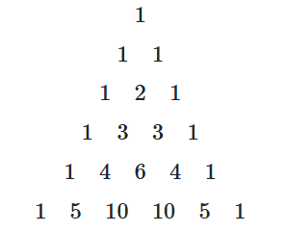










The Shape of Chance
HHTT
HTHT
HTTT
HTTH
HHHT
THTT
THHT
HHTH
TTHT
THTH
HTHH
TTTT
TTTH
TTHH
THHH
HHHH
$$\left(\begin{matrix}4 \\ 0\end{matrix}\right)=1$$
$$\left(\begin{matrix}4 \\ 1\end{matrix}\right)=4$$
$$\left(\begin{matrix}4 \\ 2\end{matrix}\right)=6$$
$$\left(\begin{matrix}4 \\ 3\end{matrix}\right)=4$$
$$\left(\begin{matrix}4 \\ 4\end{matrix}\right)=1$$
$$.0625$$
$$.2500$$
$$.3750$$
$$.2500$$
$$.0625$$

Slide 21






The Shape of Chance
$$P\left(k heads\right)=\left(\begin{matrix}n \\ k\end{matrix}\right)p^{k}{\left(1−p\right)}^{n−k}$$
HHTT
$$P\left(0 heads\right)=\left(\begin{matrix}4 \\ 0\end{matrix}\right){0.5}^{0}{\left(1−0.5\right)}^{4−0}=.0625$$
HTHT
HTTT
HTTH
HHHT
$$P\left(1 heads\right)=\left(\begin{matrix}4 \\ 1\end{matrix}\right){0.5}^{1}{\left(1−0.5\right)}^{4−1}=.2500$$
THTT
THHT
HHTH
TTHT
THTH
HTHH
$$P\left(2 heads\right)=\left(\begin{matrix}4 \\ 2\end{matrix}\right){0.5}^{2}{\left(1−0.5\right)}^{4−2}=.3750$$
TTTT
TTTH
TTHH
THHH
HHHH
$$P\left(3 heads\right)=\left(\begin{matrix}4 \\ 3\end{matrix}\right){0.5}^{3}{\left(1−0.5\right)}^{4−3}=.2500$$
$$\left(\begin{matrix}4 \\ 0\end{matrix}\right)=1$$
$$\left(\begin{matrix}4 \\ 1\end{matrix}\right)=4$$
$$\left(\begin{matrix}4 \\ 2\end{matrix}\right)=6$$
$$\left(\begin{matrix}4 \\ 3\end{matrix}\right)=4$$
$$\left(\begin{matrix}4 \\ 4\end{matrix}\right)=1$$
$$P\left(4 heads\right)=\left(\begin{matrix}4 \\ 4\end{matrix}\right){0.5}^{4}{\left(1−0.5\right)}^{4−4}=.2500$$
$$.0625$$
$$.2500$$
$$.3750$$
$$.2500$$
$$.0625$$

